Slide 1


Tutorial on Dimensional Modeling
Ali Chelli
Course: Business Intelligence and Data Warehousing (BID3000)

Slide 2
Representation of Data in DW
Dimensional Modeling
A retrieval-based system that supports high-volume query access
Star schema
The most commonly used and the simplest style of dimensional modeling
Contain a fact table surrounded by and connected to several dimension tables
Snowflakes schema
An extension of star schema where the diagram resembles a snowflake in shape

Slide 3
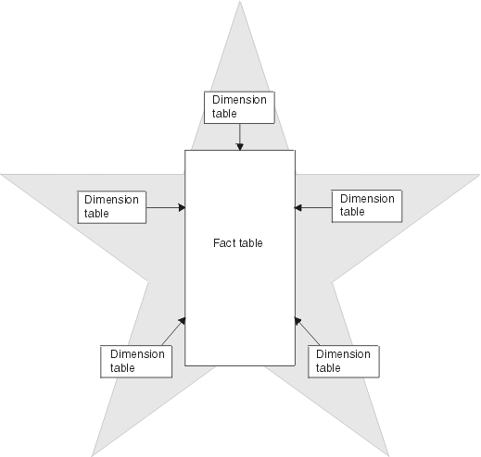
Dimensional Star Schema:

Slide 4
Fact and Dimensions
FACT TABLES
Facts are usually:
Numeric
Measure
Represent a specific business aspect or activity
Stored in a fact table at the center of the star schema
Tend to have huge numbers of records
Useful facts tend to be numeric
Contains foreign keys
DIMENSION TABLES
Attributes are descriptive
Text
Numeric
Fewer number of records
Categorizes facts and measures in order to enable users to answer business questions
Represent the context

Slide 5
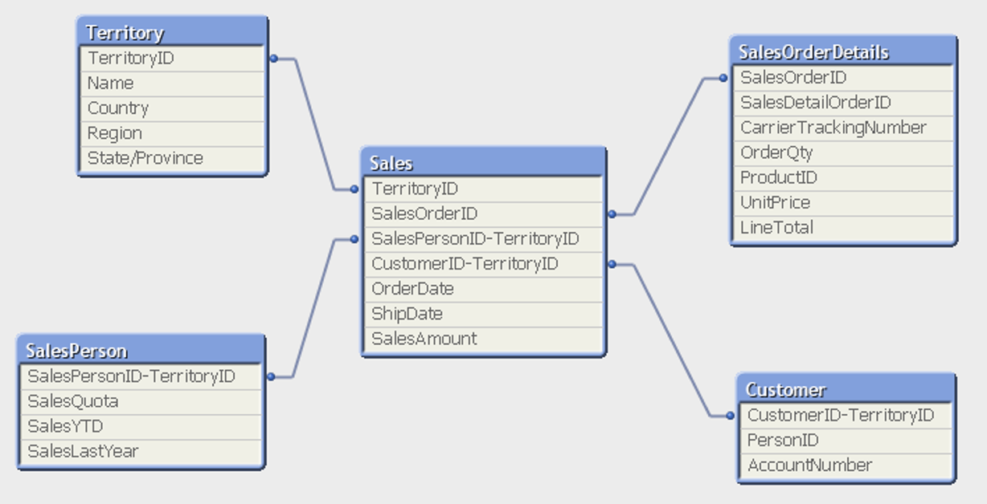
Example of a Star Schema:

Slide 6
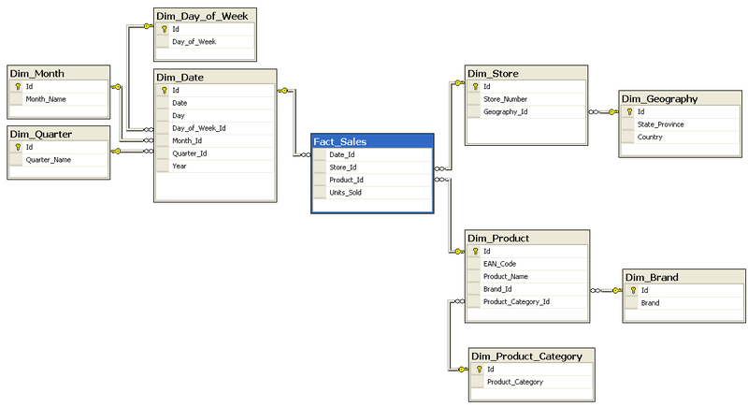
Example of a Snowflake Schema:

Slide 7
Star versus Snowflake Schema

Slide 8
Example of a Transaction System Database:

Slide 9
The Resulting Star Schema in the Data Warehouse:

Slide 10
Dimensional Modeling
https://www.youtube.com/watch?v=lWPiSZf7-uQ

Slide 11
Practical Implementation of a DW

Slide 12
CoffeeMerchant’s Database:

Slide 13
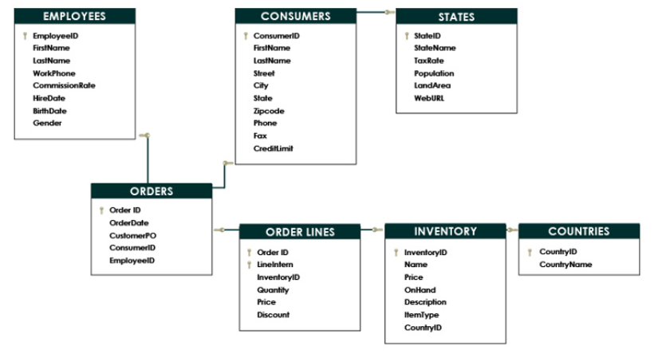
CoffeeMerchant’s Database ERD:

Slide 14
How we are going to make Business Intelligence Systems in this Course: A BI System for CoffeeMerchant
SQL-script
CoffeeMerchant
database
CoffeeMerchant
Datawarehouse
Power BI
Spoon
ETL

Slide 15
Building coffeemerchant Data Warehouse
SQL-script
CoffeeMerchant
database
CoffeeMerchant
Datawarehouse
Power BI
Spoon
ETL

Slide 16
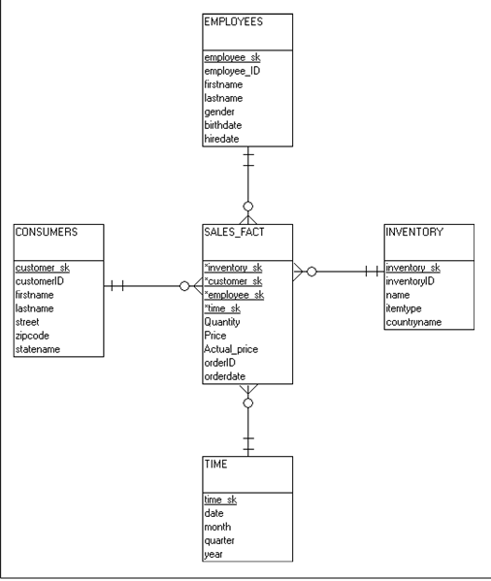
Building coffeemerchant Data Warehouse
As opposed to databases that follow relational models, data warehouse follow dimensional models.
The coffeemerchant Data Warehouse dimensional model: A star schema with one fact table and 4 dimensional tables
Fact Table: Sales_Fact
Dimension Tables:
Time,
Consumers,
Inventory,
Employee

Slide 17
Filling the Dimension Tables:
SQL procedure
dim_time
consumers
dim_customer
inventory
dim_inventory

Slide 18
Building coffeemerchant Data Warehouse
Fact tables: contains measures
Dimension tables: contains what we measure against_
SK stands for Surrogate Keys.
Surrogate Keys: New Keyes used instead of the keys in the source systems – making the data warehouse more robust to the changes that may occur for the source data.

Slide 19
Filling the Fact Table:
orders
Staging-tabell
fact_sales
orderLines

Slide 20
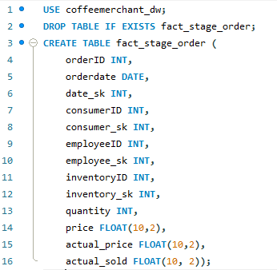
A Staging Table For Facts:
Creating the fact staging table:

Slide 21
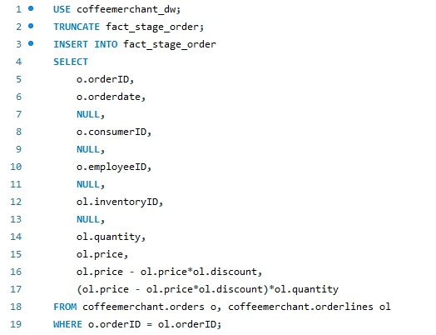
A Staging Table For Facts:
Filling the table from the source database:

Slide 22
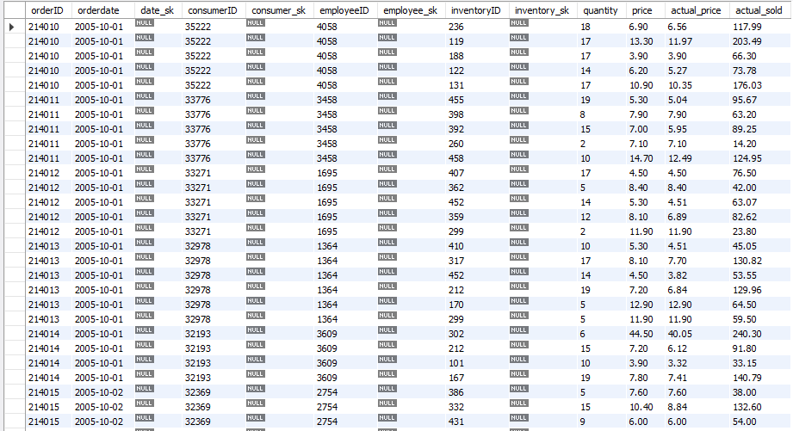
The Staging Table:

Slide 23

Adding Surrogate Keys to the Staging Table:
Filling the value of the surrogate key date_sk in the staging table from dimensional table dim_time

Slide 24

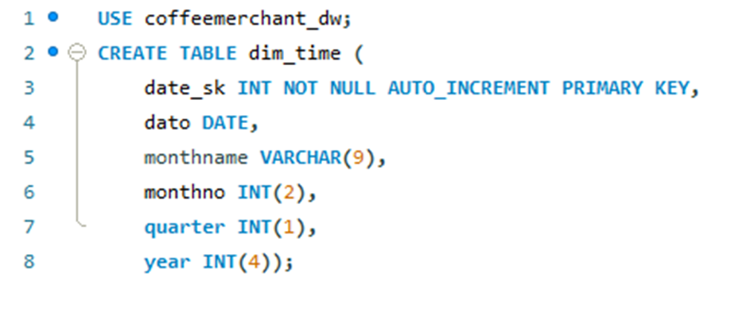
Reminder: Structure of related Tables
Dim-time
Fact_stage_order

Slide 25
Adding Surrogate Keys to the Staging Table:
Task: add the missing surrogate keys to staging table.
What are the missing surrogate keys?
Write the SQL code to add these missing surrogate keys to the staging table.

